Slide 1
Cape Town Xamarin UG
creating the Microsoft Band component
Matthew Leibowitz
matthew.leibowitz@xamarin.com
@mattleibow

Slide 2

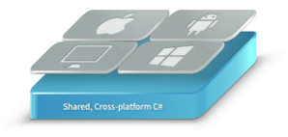

Agenda
The Microsoft Band
The Native Bindings
The Portable Class Library
The NuGet Package
The Xamarin Component
Conclusions

Slide 3
The Microsoft Band

Slide 4
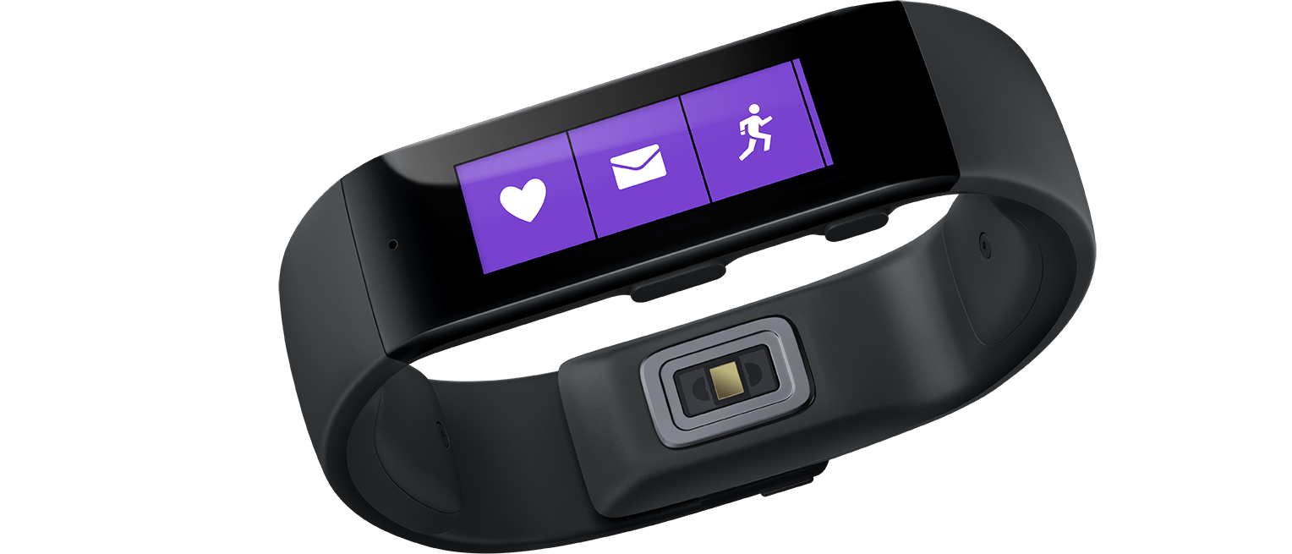
What is the Microsoft Band?
A smart band with smartwatch features
Filled with sensors
Long battery life
Cross-platform support
Notes:
10 physical sensors, but more logical
- Accelerometer – step counter
- Heart Rate – calories

Slide 5
Apps for the Microsoft Band?
Not really.
Tiles with dynamic pages (two-way communication with buttons)
Source of sensor data
Customize Band theme and wallpaper
Notifications and dialog boxes

Slide 6
The Native Bindings
Notes:
This means we can take any Java / Objective-C library and wrap it automatically into a C# and .NET assembly

Slide 7
The Native SDK
Java SDK for Android
Objective-C SDK for iOS
C# SDK for Windows Phone
C# SDK for Windows Store
3 languages, 3 patterns, 3 times
Notes:
Quite good, it follows the native platform patterns
Three languages – WP/WS use the same, but they aren’t true PCL libraries
Each app flows slightly differently and requires different objects

Slide 8
The Xamarin Native SDK
C# SDK for Android
C# SDK for iOS
C# SDK for Windows Phone
C# SDK for Windows Store
1 language, 3 patterns, ~3 times
Notes:
Just dropping the iOS/Android library into the tools and letting it do the work.
Straight bindings are fairly easy. Most of the time, they only require a few tweaks in order to get them to work.
However, they are very platform-style APIs
- Still follows the platform and language patterns
- listeners in Android,
delegates in iOS
- AsyncTask in Android,
completion handlers in iOS

Slide 9
The Improved Xamarin Native SDK
C# SDK for Android
C# SDK for iOS
C# SDK for Windows Phone
C# SDK for Windows Store
1 language, 1 pattern, ~3 times
Notes:
Using overloads instead of numerous methods
Using properties instead of getters/setters
Making the asynchronous methods use Task, async and await
Using events instead of listeners
Converting NSMutableArray into .NET collections

Slide 10
The Portable Class Library

Slide 11
What are Portable Class Libraries (PCL)?
An assembly that is not restricted to a specific platform
Types are mapped to their real types
Usable by other PCLs

Slide 12
The Same API & Code
Simply use a portable assembly everywhere
Pros:
Write once, test once, run everywhere
Cons:
The API is usually not as large

Slide 13
The Same API & Few Code Differences
Use a portable assembly everywhere
Abstract platform differences into base types or interfaces
Pros:
Clean code
Cons:
Quite a few types
Notes:
Not recommended if there are multiple types that need sharing as this results in exponential type incteases

Slide 14
The Same API & Quite Different Code
Create a dummy portable assembly
Make use of the “bait-and-switch” pattern
Pros:
Easy to consume
Cons:
Code might become messy

Slide 15
The NuGet

Slide 16
What are NuGets?
A zip archive that contains a collection of assemblies, scripts and files
Contains folders for each platform
The IDE selects the files from the correct folder
Pros
Consumable from Visual Studio/Xamarin Studio/MonoDevelop
Versioned Dependency tracking
Cons
Vast pit of them
Not monitored/controlled

Slide 17
The Xamarin Component

Slide 18
What are Xamarin Components?
A zip archive that contains a collection of assemblies, scripts and files
Contains folders for each platform
The IDE selects the files from the correct folder
Pros
Curated list
Samples/Documentation/Guaranteed cross-platform
Cons
Requires Xamarin

Slide 19
Xamarin Components Can Use NuGets!
Best of both worlds
Pros
Highly visible packages
Great interface
Cons
Nothing ☺

Slide 20
Conclusions

Slide 21
Links
Microsoft Band Developer Page http://developer.microsoftband.com/
NuGet https://nuget.org/packages/Xamarin.Microsoft.Band/
Xamarin Component http://components.xamarin.com/view/microsoft-band-sdk
GitHub https://github.com/mattleibow/Microsoft-Band-SDK-Bindings

